Slide 1

Pthread and OpenMP Implementation of a 9-point Stencil Operation
By: Michael Dandrea

Slide 2

Project Background
Implement Pthread and OpenMP Version of a 9-point stencil operation
Gather and plot information about speedup, timing, efficiency and serial fraction.

Slide 3
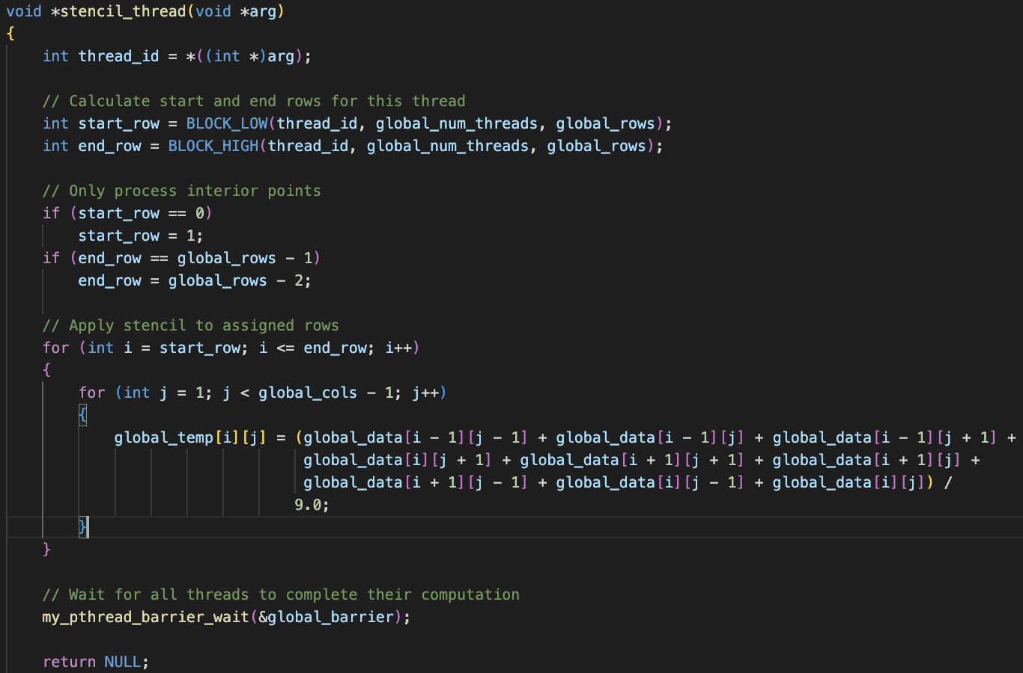
Pthread Implementation
Notes:
Thread Initialization: Each thread receives an ID through the arg parameter, which is cast to an integer.
Row Assignment: The function calculates the range of rows (start_row and end_row) that the thread is responsible for processing. This ensures that the workload is evenly distributed among all threads.
Boundary Adjustment: The code adjusts the start and end rows to avoid processing the boundary rows, focusing only on the interior points.
Stencil Operation: The core of the function is a nested loop that applies the stencil operation to each assigned row. The stencil operation averages the values of a 3x3 neighborhood around each point in the global_data array and stores the result in the global_temp array.
Synchronization: After completing the computation, the thread waits at a barrier (my_pthread_barrier_wait) to ensure all threads finish their work before proceeding.

Slide 4
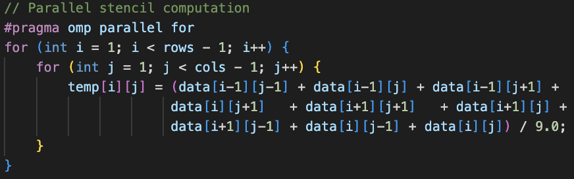
OpenMP Implementation
Notes:
The #pragma omp parallel for directive parallelizes the outer loop, allowing multiple threads to process different rows of a 2D array concurrently. Each thread updates the temp array by averaging the values of each point and its eight neighbors from the data array, excluding the boundary points.

Slide 5
Result Gathering and Plotting
Ran on Expanse
SLURM script
Four total python scripts
run_all.sh
Notes:
All tests were ran on the Expanse supercomputers compute node. The tests included four different matrix sizes, 5kx5k, 10kx10k, 20kx20k and 40kx40k. Each of these matrices was ran on both implementations of the stencil on 1, 2, 4, 8 and 16 threads. These results were then stored in a csv file and used to plot the efficiency, speedup, timing, and serial fraction graphs.
This included four total python scripts, two to run the tests and two to plot the results. There is also a run_all shell script to conduct these tests on a local machine.

Slide 6
Pthread Results

Slide 7
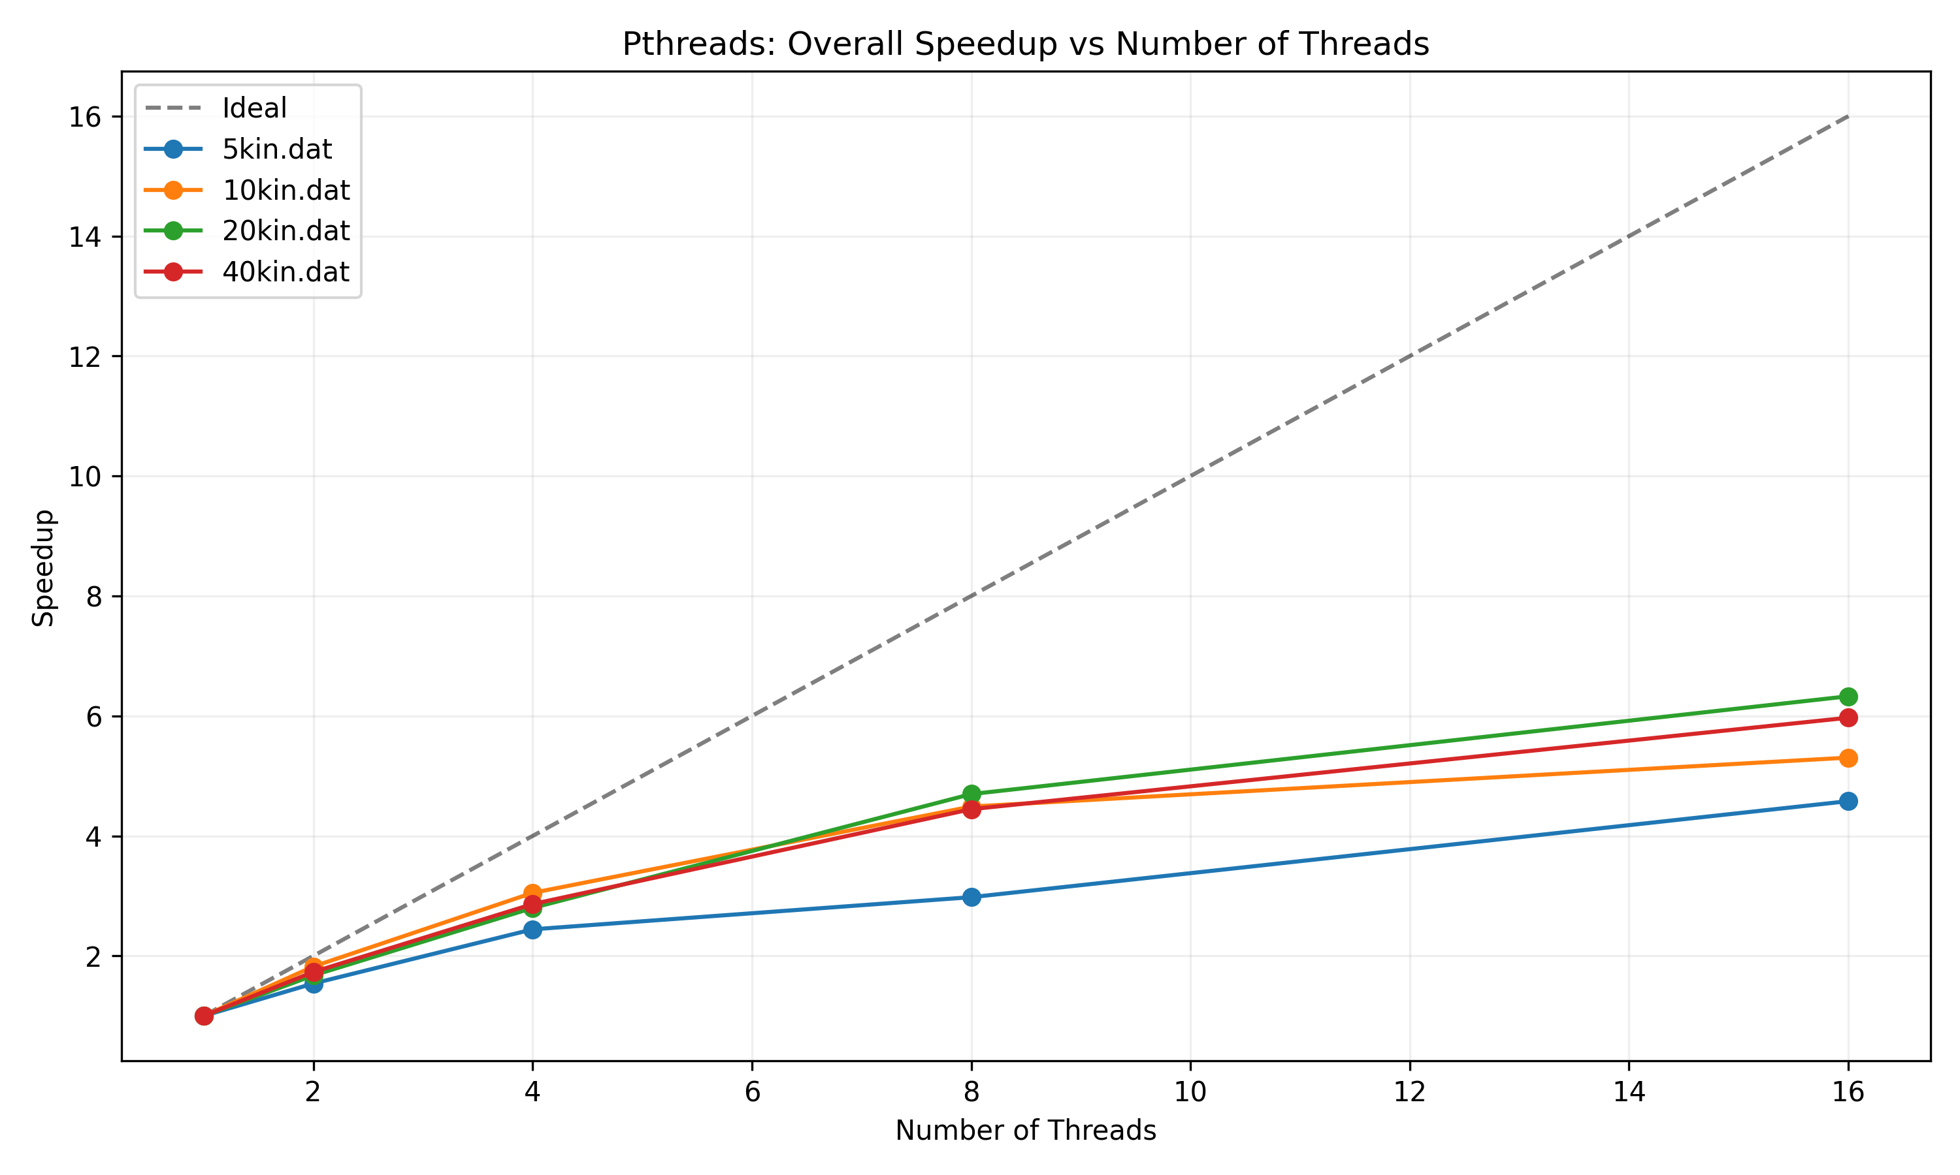
Overall Speedup
Notes:
This is the overall speedup graph. As we can see, each test gets further from the ideal speedup as we increase the amount of threads. This is because as we increase the number of threads, more time has to be spent waiting for threads to complete their critical section before any other thread can access a critical section, as well as time taken to create and destroy threads.
The 20kx20k matrix has the best ending speedup at around 6.2x, and the 5kx5k matrix has the worst at around 4.3x

Slide 8
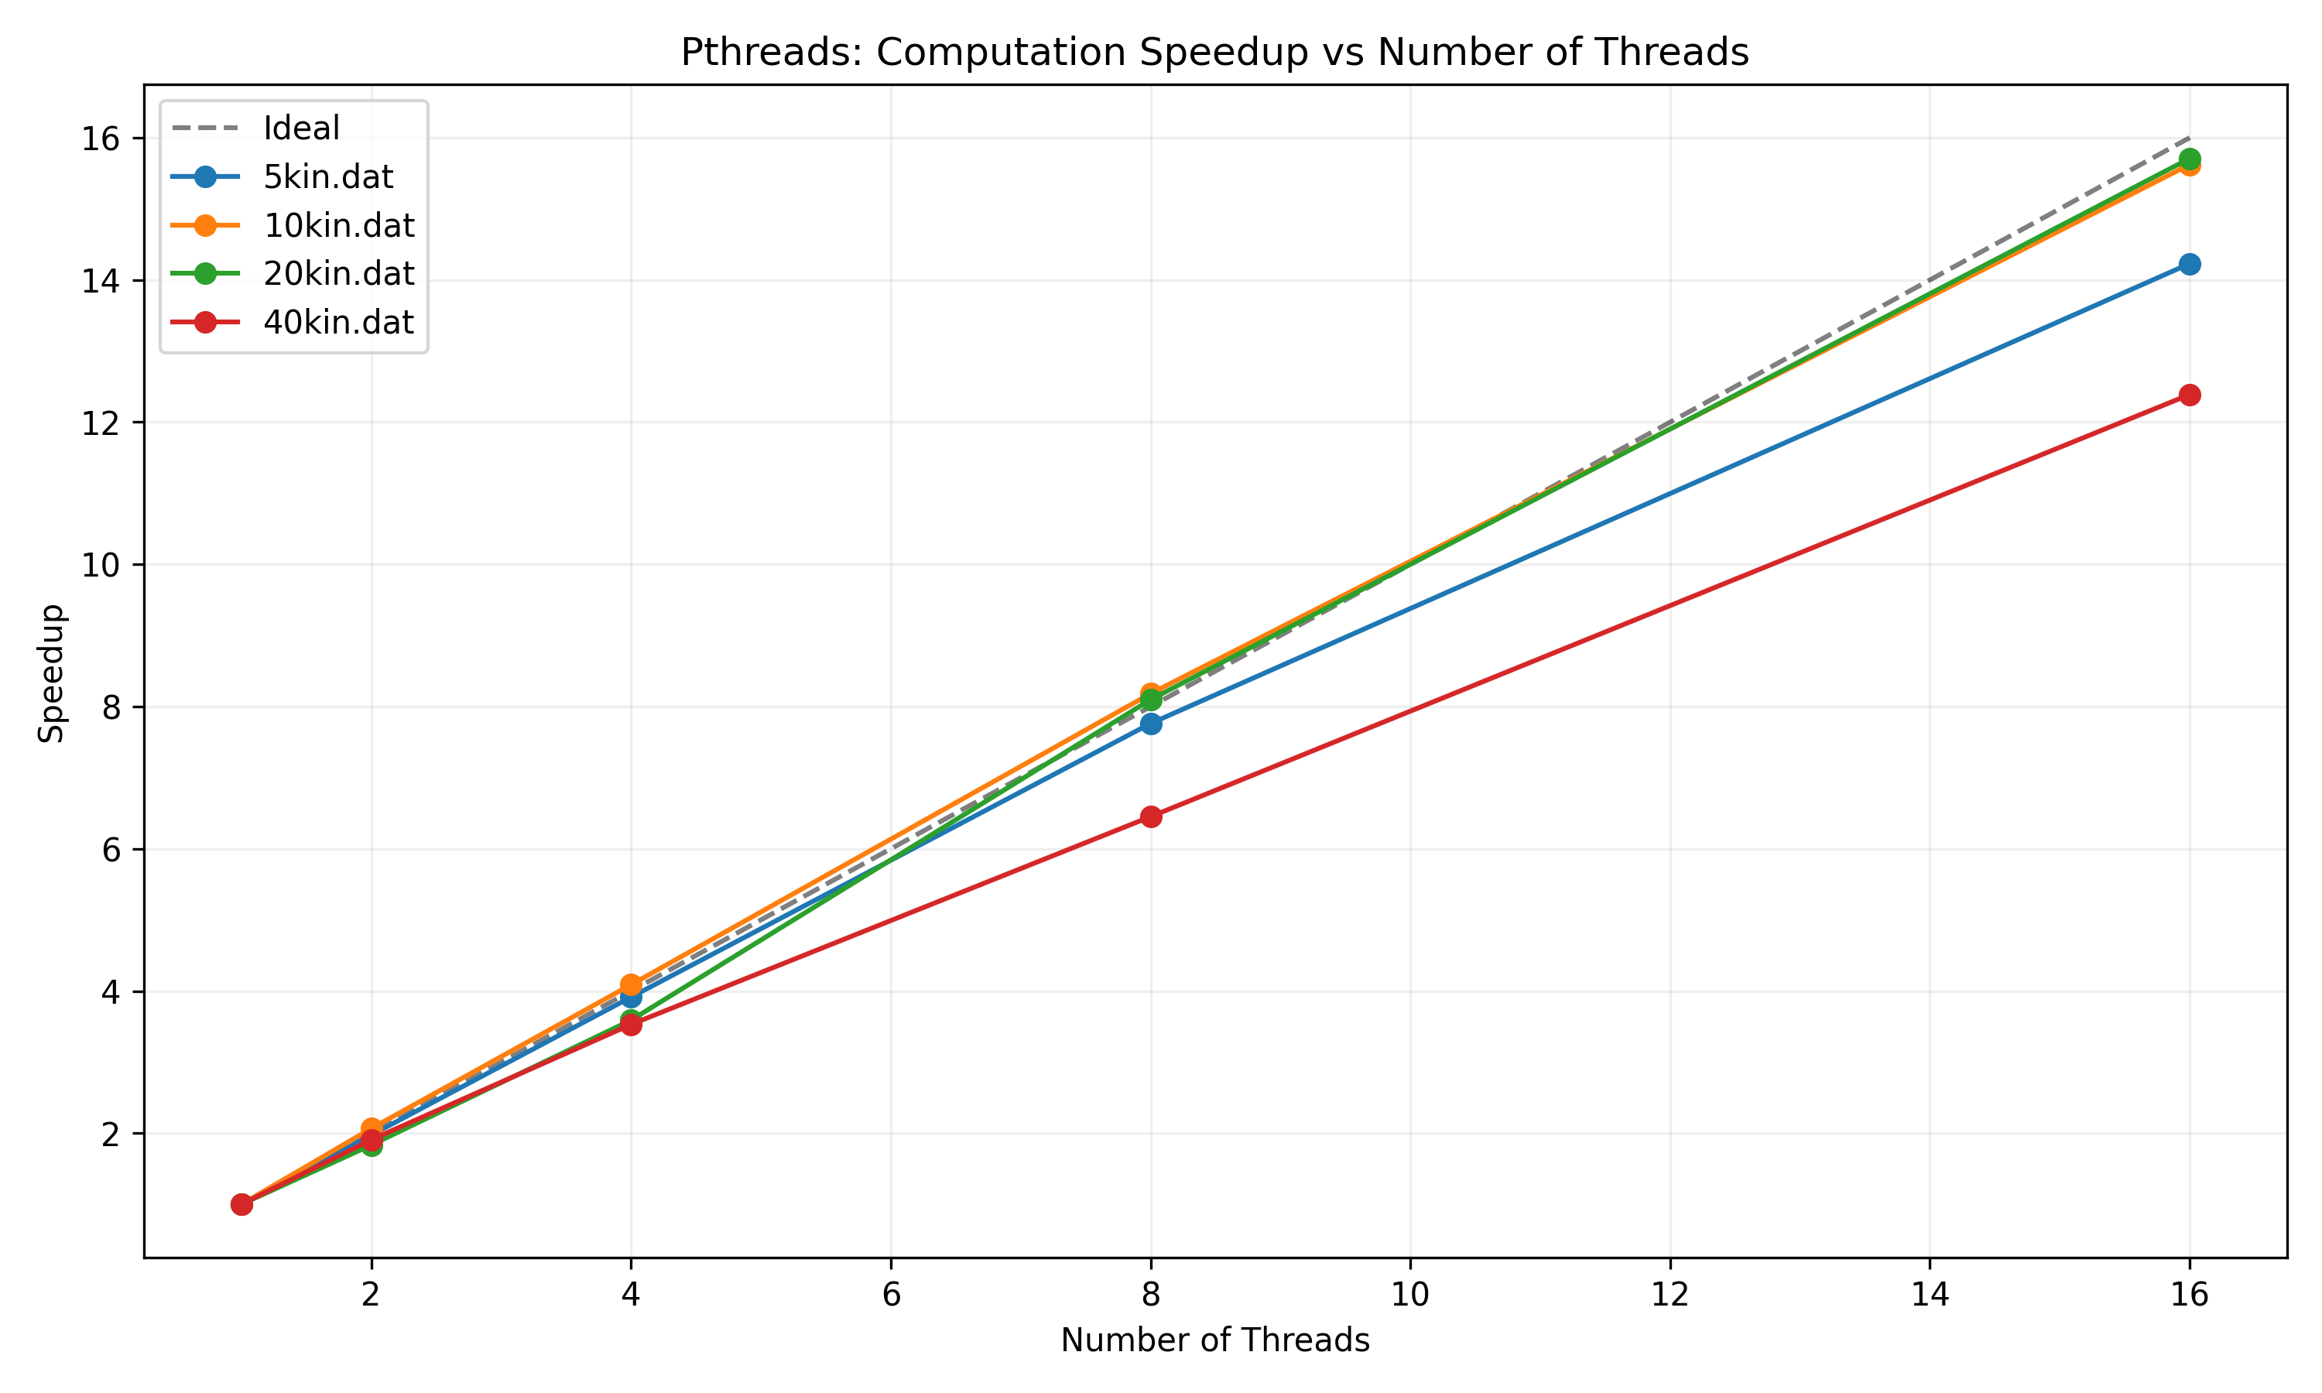
Computation Speedup
Notes:
This is the computation speedup graph. As we can see, this is much closer to the ideal speedup than the overall was. This means that the stencil computation itself is highly parallelizable, and that the computation time becomes a smaller portion of the overall time as we increase the number of threads.
The 10kx10k and 20kx20x matrices have almost the same speedup here, at just under 16x with 16 threads. The 40kx40x has the worst, at just over 12x speedup with 16 threads.

Slide 9
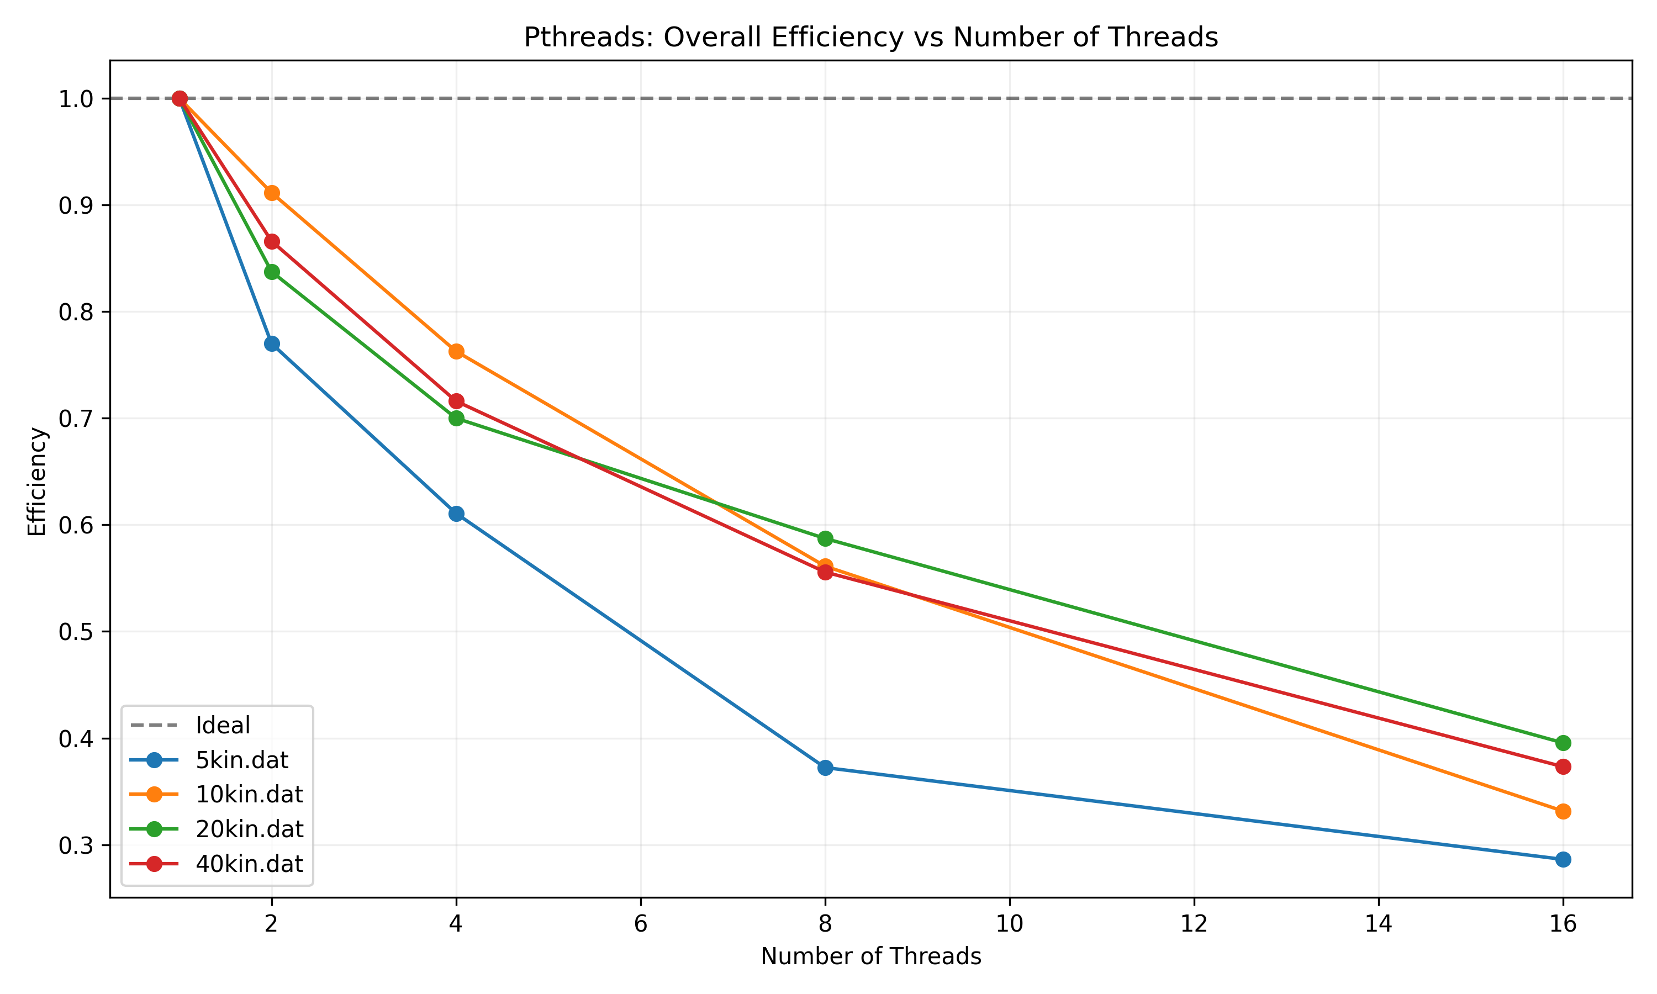
Overall Efficiency
Notes:
This is the overall efficiency graph. As we can see, the efficiency goes down as we increase the number of threads. This makes sense because the threads are not all spawned at the same time. This means that there is downtime for threads as we have to keep spawning more before the computation starts.
The 10kx10k matrix starts off with the highest efficiency, but ends up losing to the 20kx20k matrix at the end, which has about 40% efficiency on 16 threads. The 5kx5k matrix has the worst efficiency across every number of threads, ending at a less than 30% efficiency with 16 threads.

Slide 10
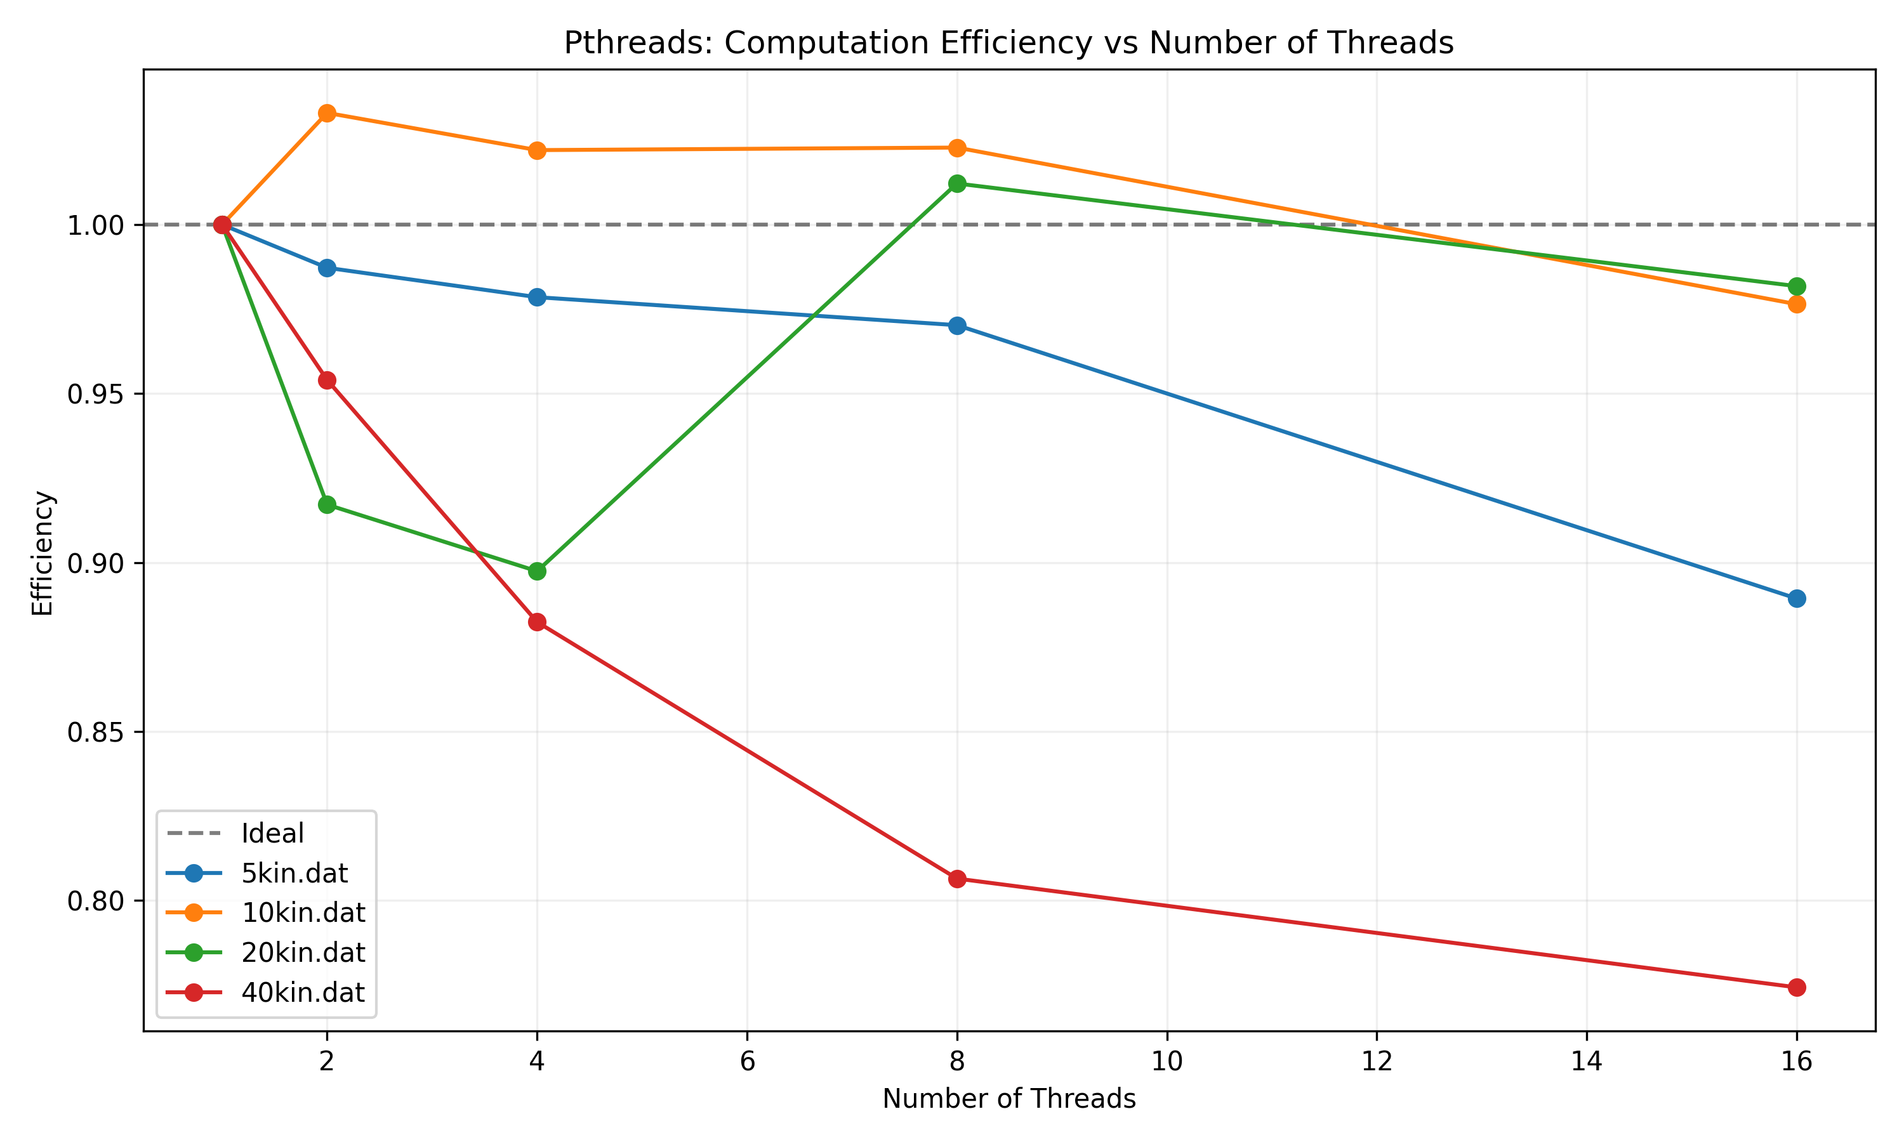
Computation Efficiency
Notes:
This is the computation efficiency. One very noticable factor here is that the 10kx10k matrix has over 100% efficiency for quite a while, with the 20kx20k matrix joining it there at 8 threads. I will go more in depth on that when I talk about the serial fraction.
Surprisingly, even though it has above 100% efficiency everywhere else, the 10kx10k matrix just barely loses to the 20kx20k matrix on 16 threads, where they both have about 97% efficiency. The 40kx40k matrix is the clear loser here, where it has about a 76% efficiency on 16 threads.

Slide 11
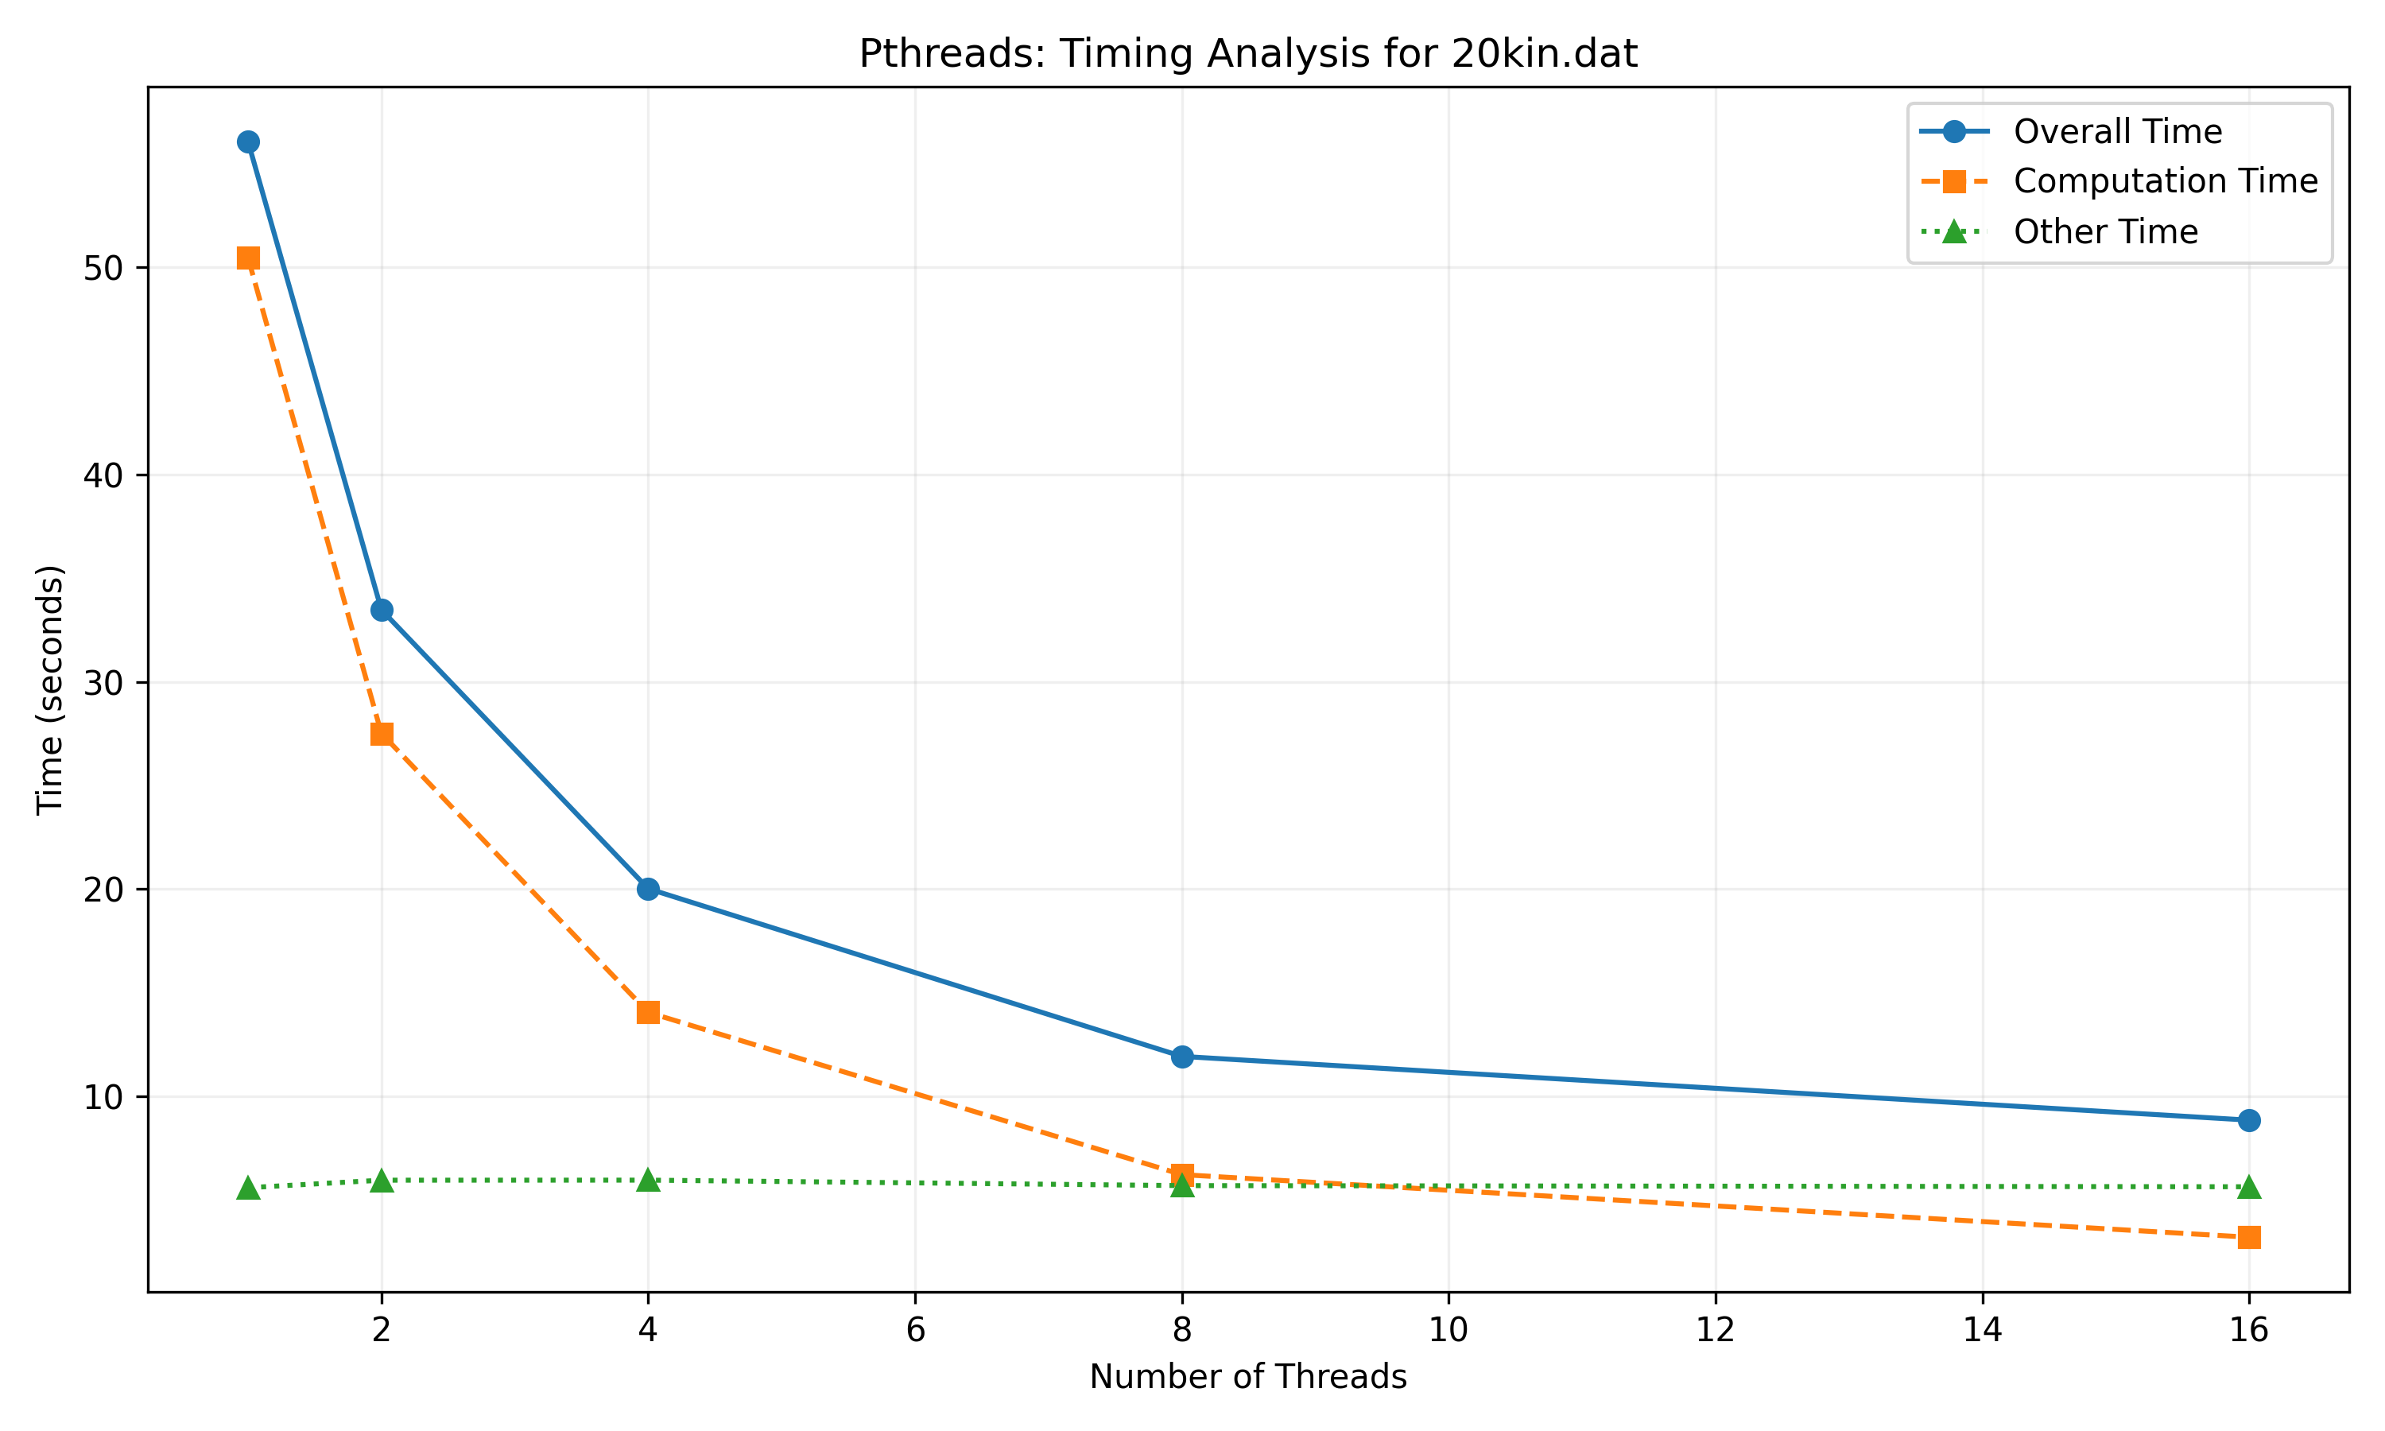
Timing Example
Notes:
This is an example of the timing plots made. This one is for the 20kx20k matrix. It shows the overall time, computation time and other (or I/O / overhead) time at each thread count.
Something interesting to note here is that the computation time actually ends up being less than the other time at 16 threads, and they are almost equal at 8 threads.

Slide 12
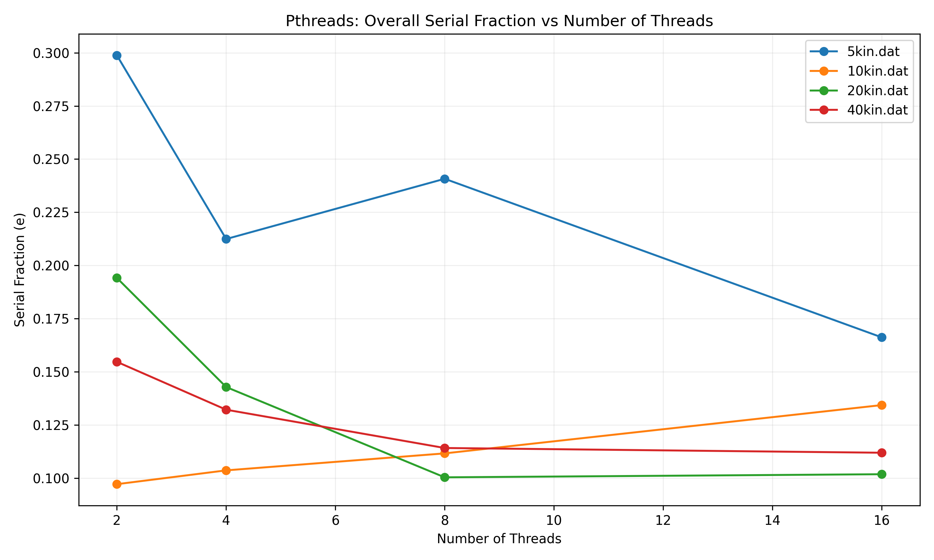
Overall Serial Fraction
Notes:
This is the overall serial fraction graph. It represents the approximate portion of the program that is serial, or the portion that cannot be parallelized. This comes from the equation for the Karp-Flatt metric from the Pacheco text.
The 5kx5k matrix clearly has the largest serial fraction, with the others coming real close to each other at 8 threads, but the 20kx20k matrix ends up with the smallest fraction on 16 threads.

Slide 13
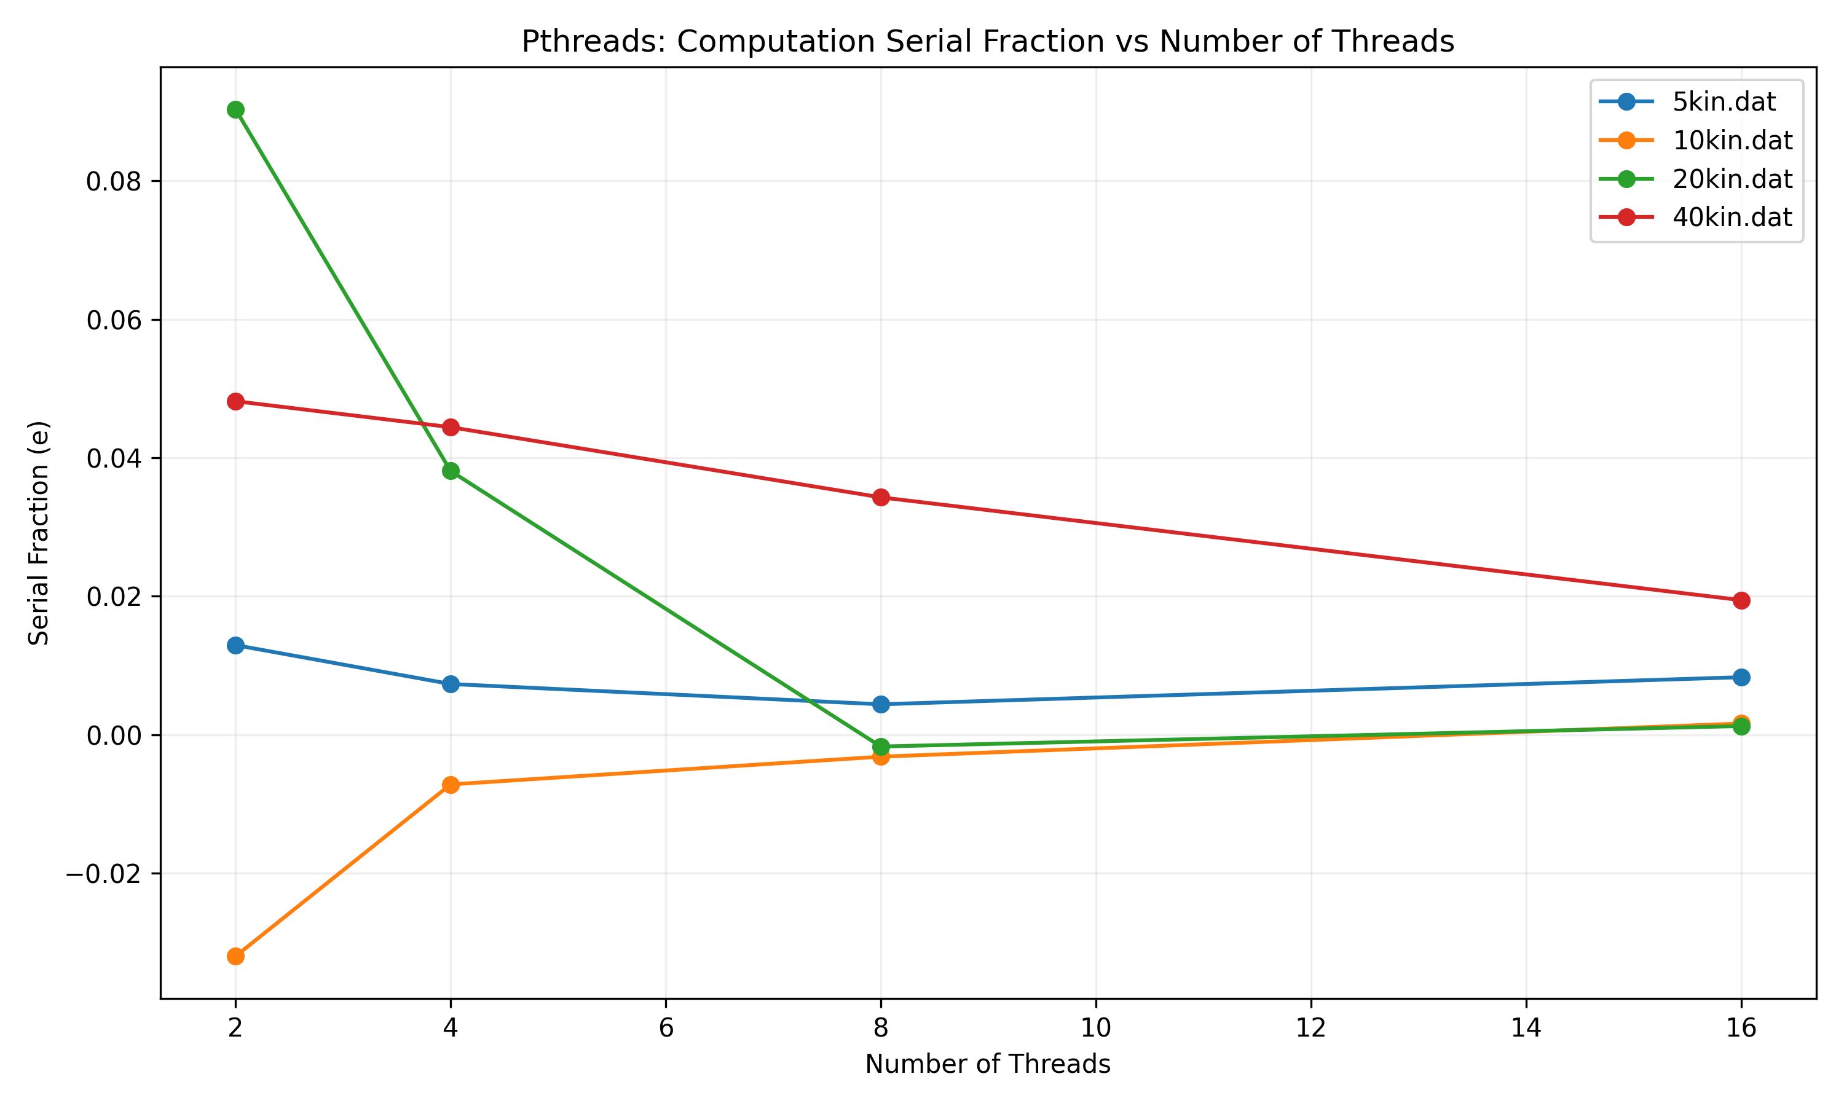
Computation Serial Fraction
Notes:
This is the computation serial fraction graph. Something very interesting here is that the 10kx10x matrix has a negative serial fraction. This goes back to it's computation efficiency. Because its computation efficiency was over 100%, it has a negative serial fraction. This means that the time spent in serial execution is less than the observed execution time of the parallel sections. At 16 threads, however, all four versions are close to each other, all between 0 and 0.02.

Slide 14
OpenMP Results

Slide 15
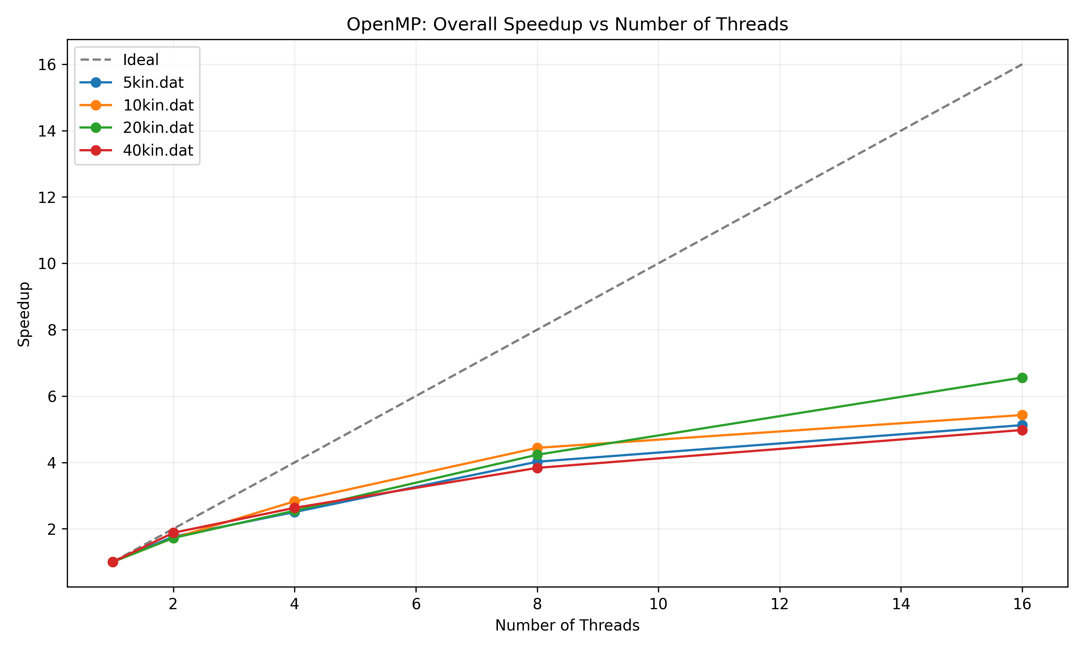
Overall Speedup
Notes:
Here we can see that the 20kx20k matrix has the highest overall speedup at around 6.3x on 16 threads, and the other three matrices are very close to each other at around 5x overall speedup.

Slide 16
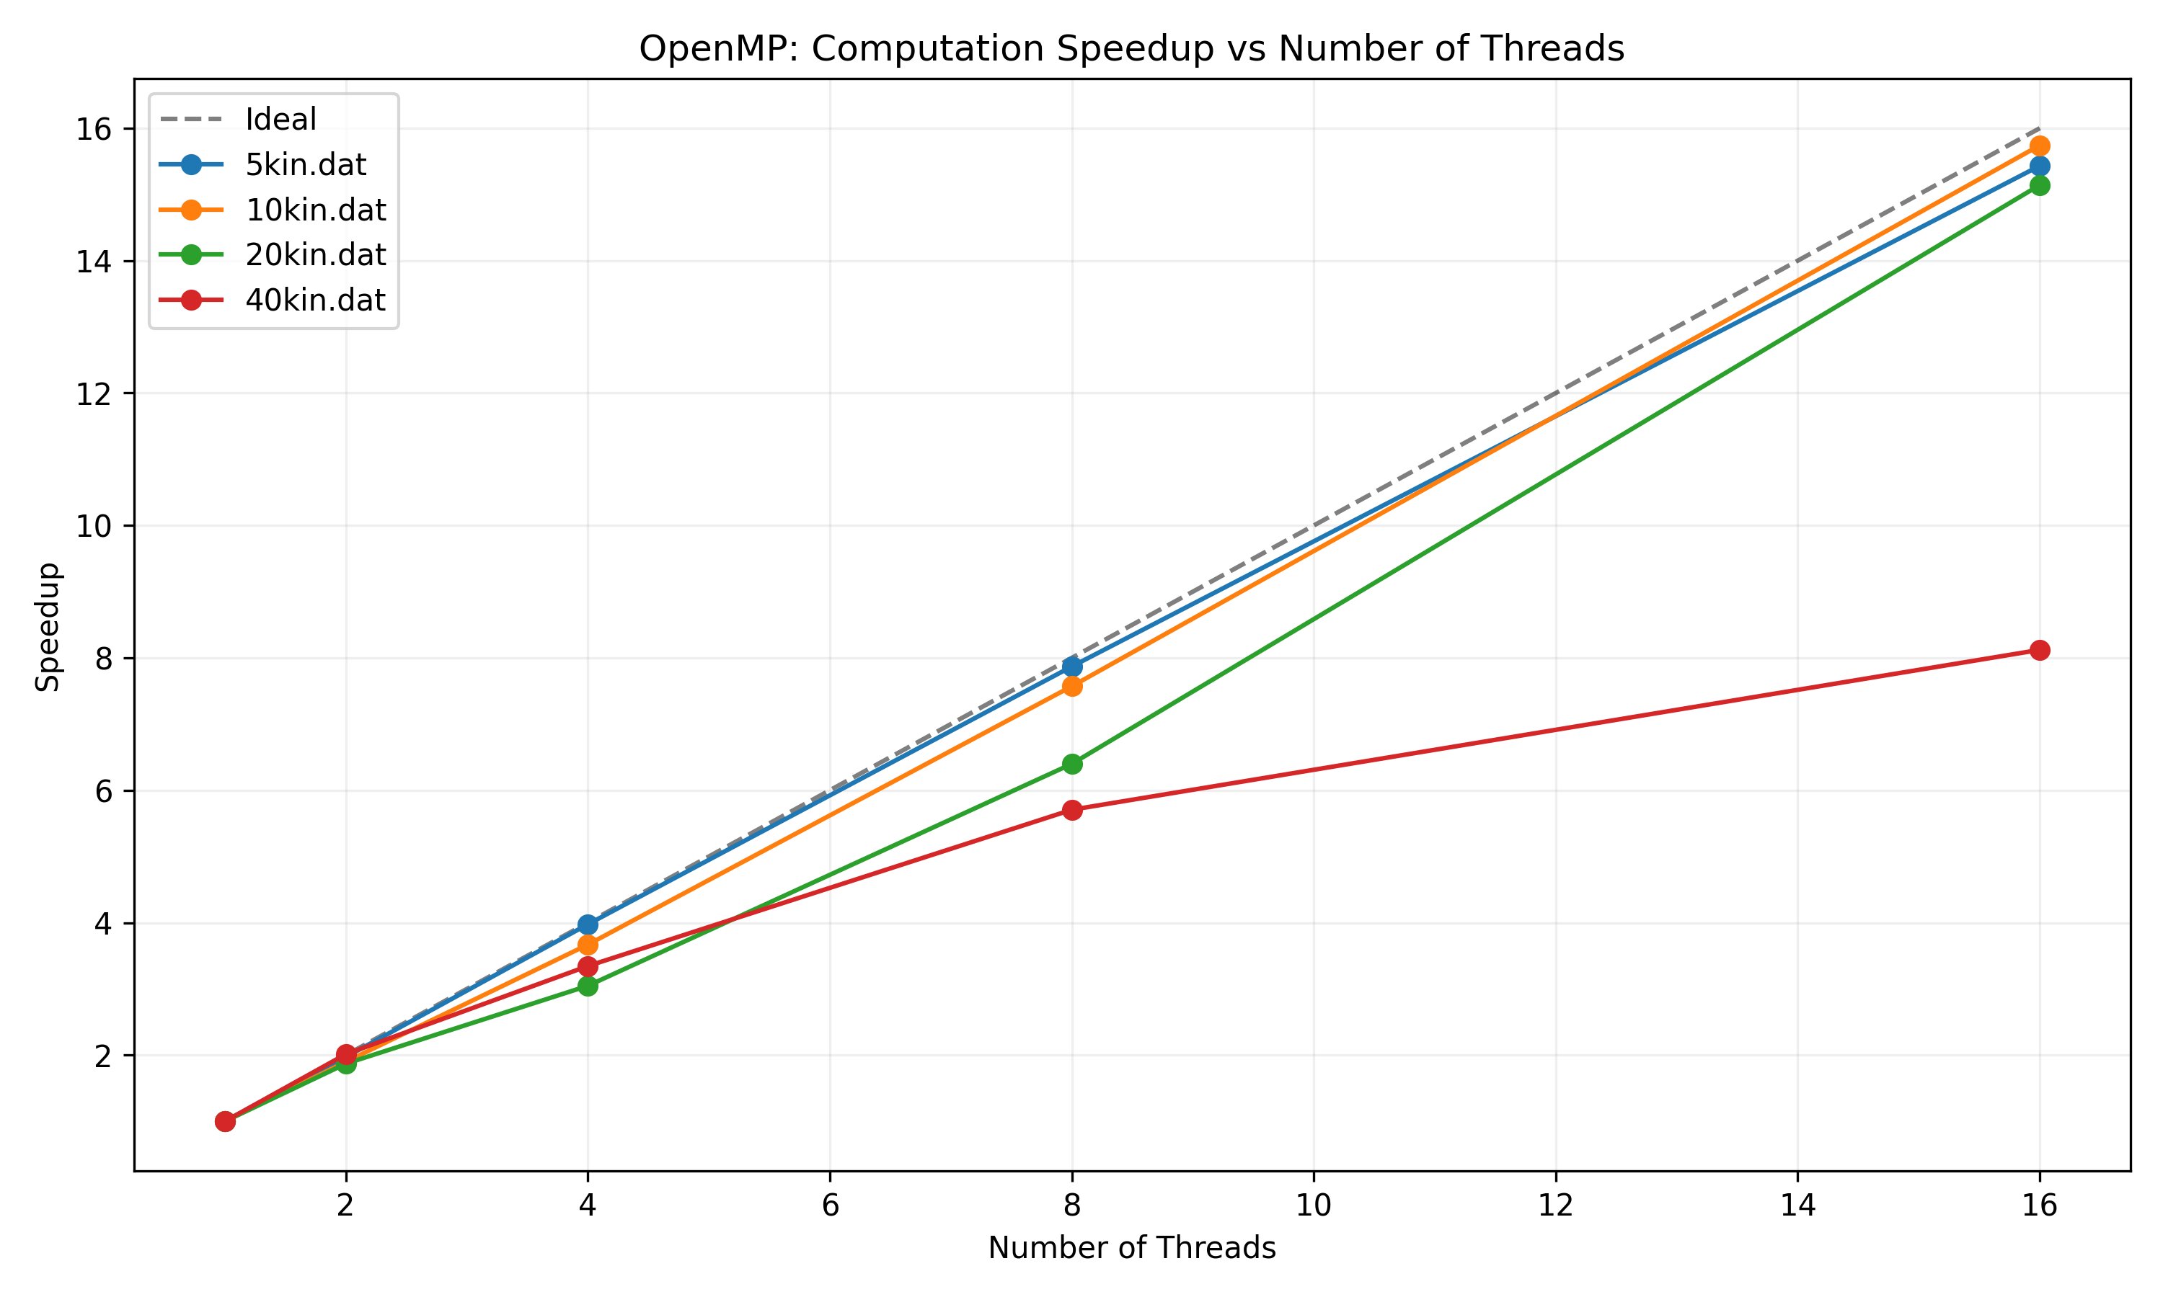
Computation Speedup
Notes:
For computation speedup, the three smaller matrices are all very close to ideal speedup, all ending at just over 15x on 16 threads. Something interesting here is that the 40kx40k matrix only has a 8x speedup on 16 threads.

Slide 17
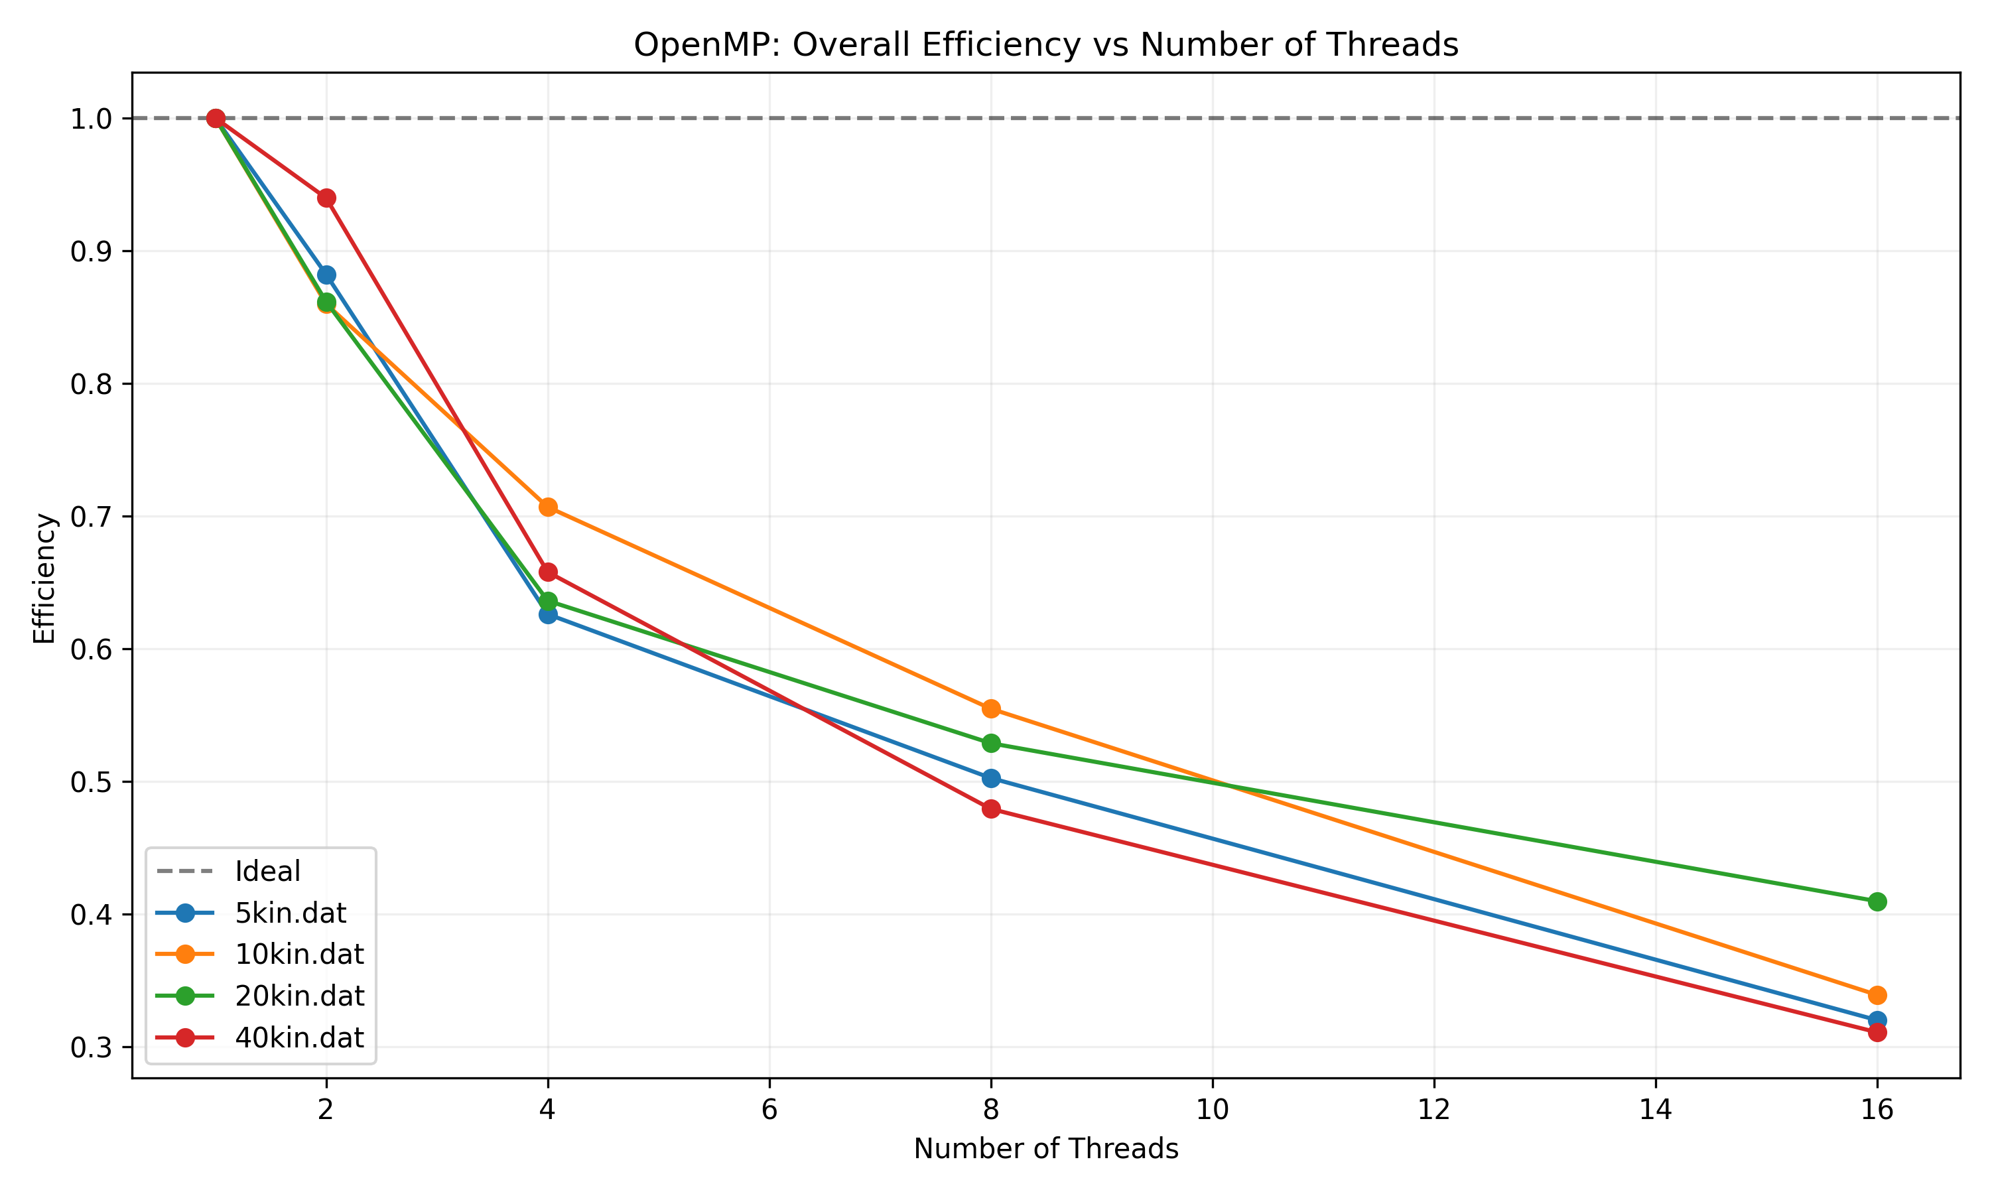
Overall Efficiency
Notes:
The overall efficiency looks very similar to the pthread efficiency, with the efficiency going down as we increase number of threads. This again makes sense as not all of the threads are spawned at the same time, meaning some have idle periods.The 20kx20k matrix ends with the highest efficiency at just over 40% and the other three are all around 32%.

Slide 18
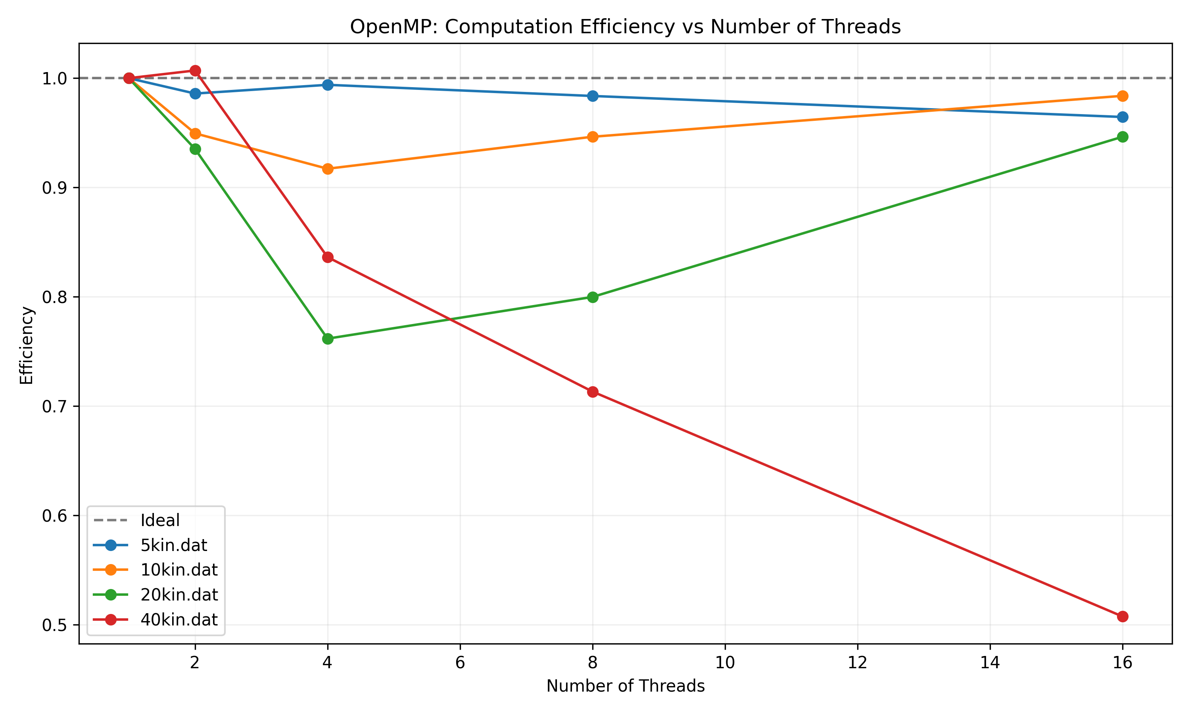
Computation Efficiency
Notes:
The computation graph looks very different from the pthread version, with the 40kx40k matrix just barely going over 100% efficiency on two threads, but falling down to about 51% efficiency on 16 threads. The other three all end close to each other at around 96% efficiency. Something interesting is how the 20kx20k matrix actually becomes more efficient between 4 and 16 threads.

Slide 19
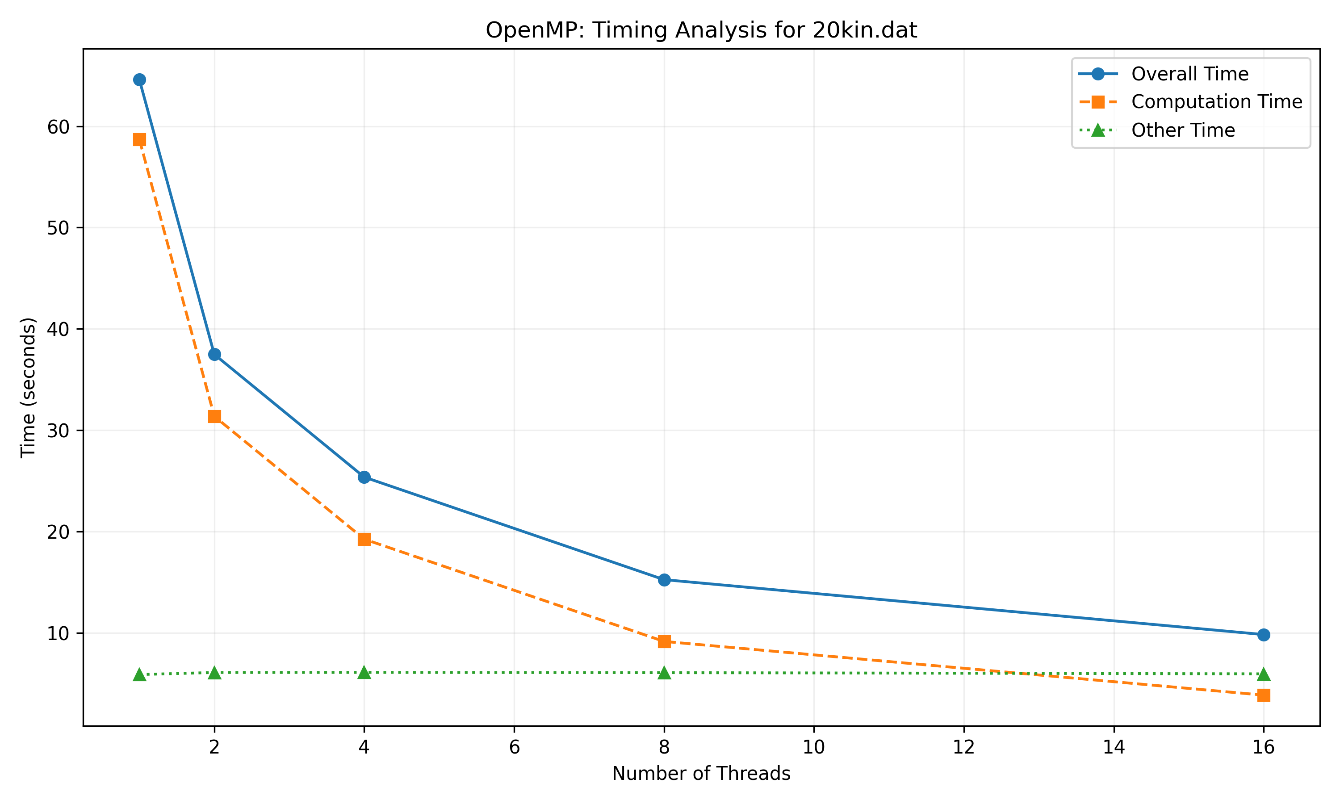
Timing Example
Notes:
Here is another timing graph, which has the same behavior as the pthread version. The computation time and "other" time get close to each other on 8 threads, and computation ends um being less than "other" on 16 threads.

Slide 20
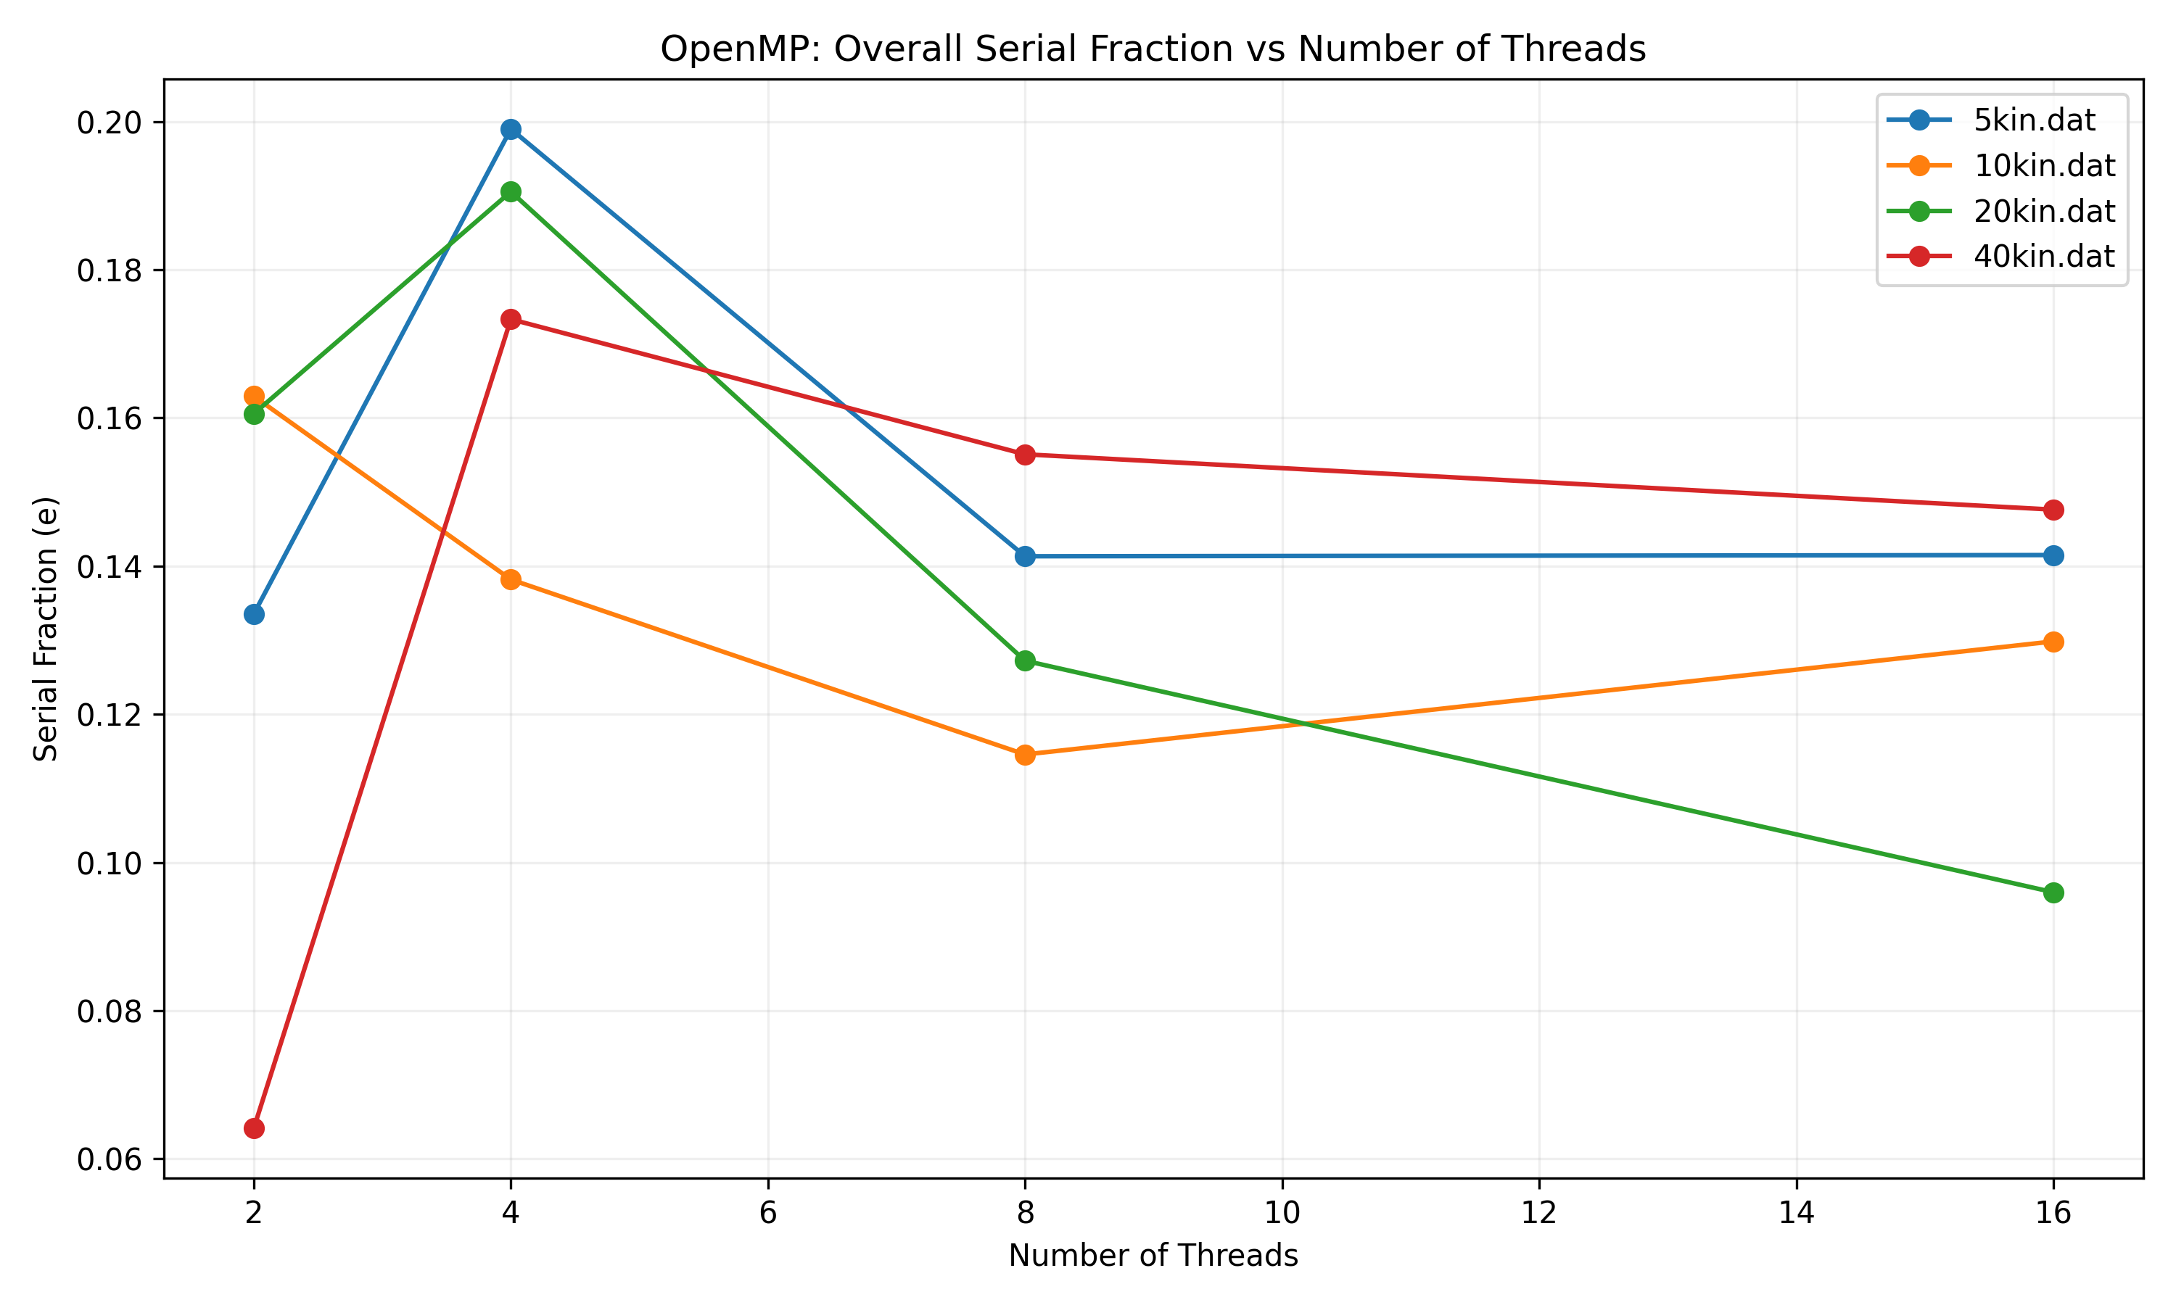
Overall Serial Fraction
Notes:
The overall serial fraction looks very different from the pthread version. The seria. fraction for the 40x40 matrix actually ends up getting bigger here. The same happens for the 5x5 matrix. The 20x20 matrix ends with the smalles serial fraction at just under 10%.

Slide 21
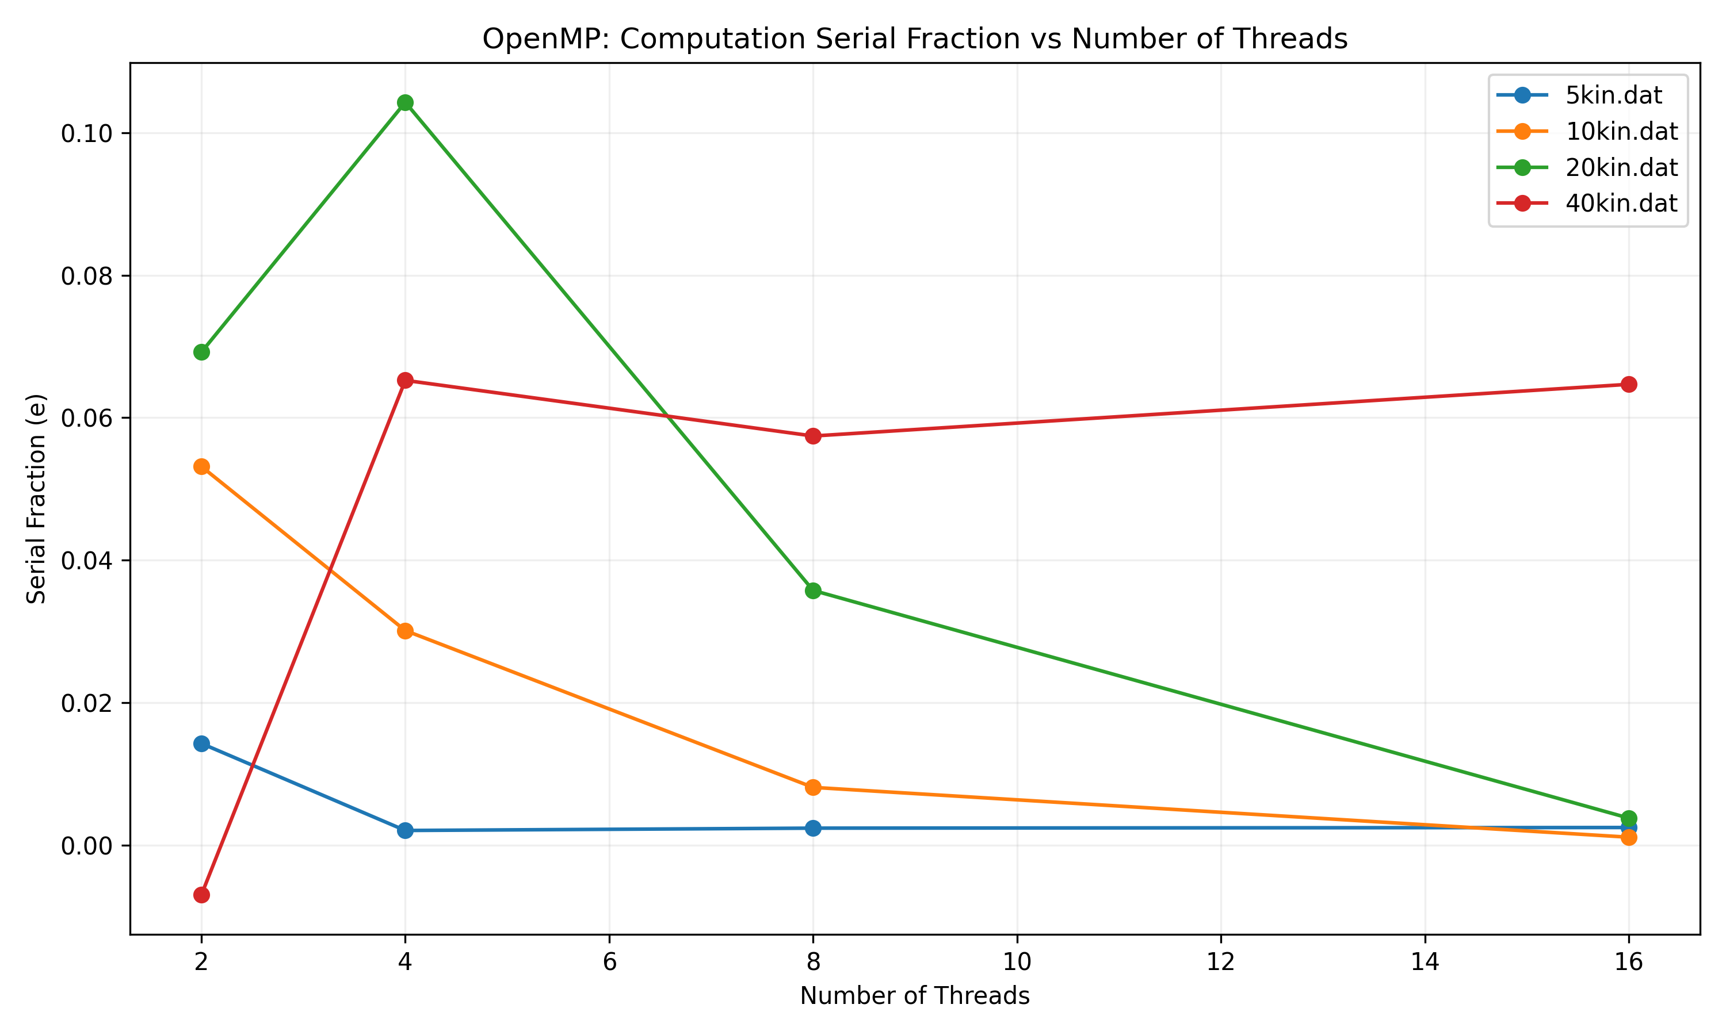
Computation Serial Fraction
Notes:
The computation serial fraction also looks very different from the pthread version. Because the 40x40 matrix has above 100% efficiency on 2 threads, it has a negative serial fraction on two threads. It ends with the highest, at just over .06 on 16 threads. The other 3 all end very close to each other, just barely over 0.

